Slide 1
Intro to Python (Part 1)
Workshop Lead: Benjamin Z. Rudski
Date: July 16, 2024

Slide 2

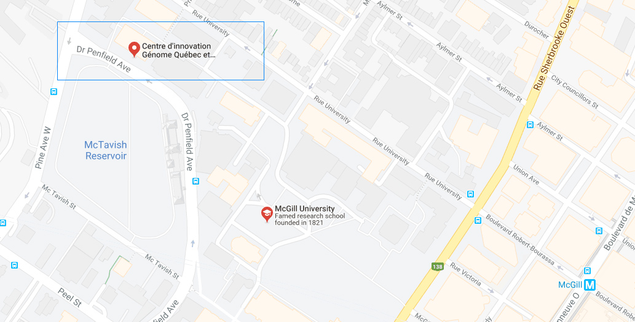
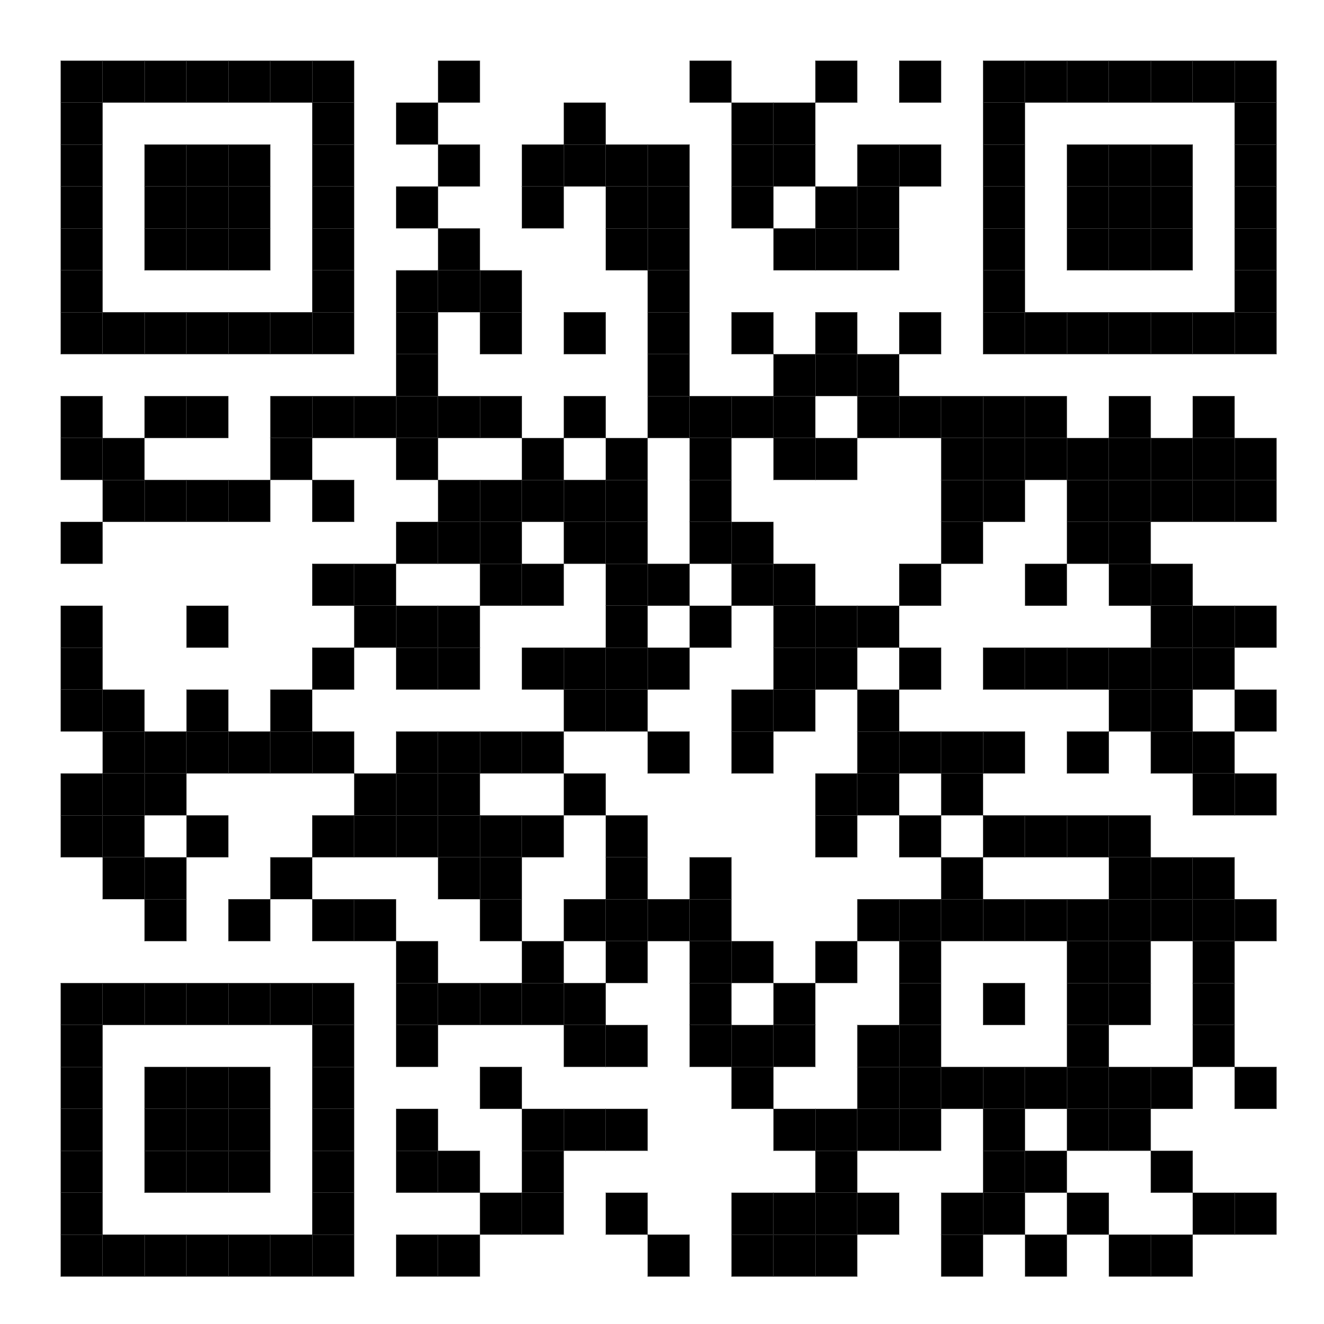
Mission statement: deliver quality workshops designed to help biomedical researchers develop the skills they need to succeed.
Location: 740 Dr. Penfield Avenue, Montreal, Quebec
Scan the QR code to sign up
for our mailing list
Contact: workshop-micm@mcgill.ca

Slide 3
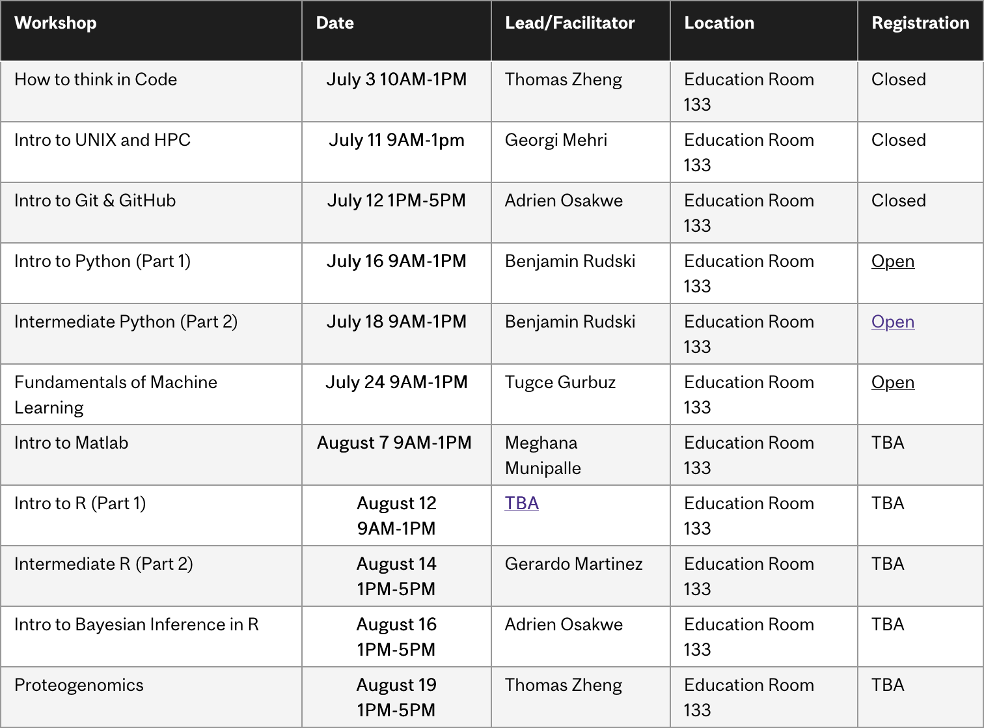
Summer 2024 Workshop Series
https://www.mcgill.ca/micm/training/workshops-series

Slide 4
About me
BSc from McGill in Hon. CS/Bio, Minor Math
Third-year PhD candidate in Quantitative Life Sciences (QLS)
Research on trabecular bone structure in the Reznikov Lab, McGill Bioengineering
3D image processing and analysis
Programming is an almost-daily task in my life!
https://github.com/bzrudski

Slide 5
Outline
Module 1 – Introduction to Programming (30 minutes)
Basic Concepts and Definitions
Welcome to Python
Module 2 – Python Basics (1 hour, 15 minutes)
Foundations of Python - A Brief Overview of Types and Variables
Numbers and Comparisons
Intro to Control Flow and Loops (if, while and for)
Exercise
Module 3 – Strings and Collections: An Object Primer (1 hour)
Introducing the String!
Introduction to Tuples, Lists and Dictionaries
Exercise
Module 4 – Modules and Packages (40 minutes)
Using Modules
Package Management
Exercise
Module 5 – Where to go from here (10 minutes)
What to learn next? How?
How to get help and how not to get help?
Other cool programming topics

Slide 6
Module 1 Introduction to Programming

Slide 7
Module Outline
Basic Concepts and Definitions
What is a Computer?
What is a Program?
What are Programming Languages?
Welcome to Python
What is Python?
How to Install Python
Tools for Using Python

Slide 8
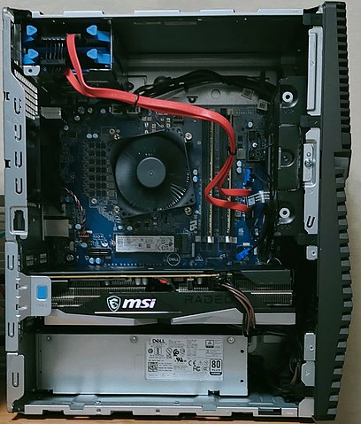
Basic Concepts and Definitions
What is a computer?
Hard drive
CPU
RAM
Motherboard
Graphics Card
Power Supply
Dell G5 5000 motherboard.jpg, by Project Kei, licensed under the Creative Commons Attribution-Share Alike 4.0 International license.

Slide 9
Basic Concepts and Definitions
What is a computer?
RAM: memory – store data
CPU: processor – perform operations on data
How do we tell it what operations to do on what data?...
Programming!
Program is a text file that contains instructions:
What operations to do
On what data

Slide 10
Basic Concepts and Definitions
What is a program? – Instructions
How do we write a program?
Using a programming language
Poll: Who does the programming language help?
(a) The computer
(b) The programmer
(c) Nobody… it’s a useless waste of time!
Let’s see why…

Slide 11
Basic Concepts and Definitions
Gene Expression
DNA
mRNA
Protein
Program (text file)
Executable (binary instructions)
Compilation or Interpretation

Slide 12
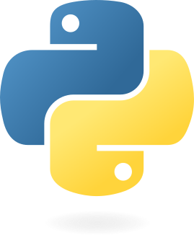
Welcome to the Python Programming Language!
For more history: https://en.wikipedia.org/wiki/History_of_Python
Introduced in 1991 by Guido van Rossum
Features:
Free and Open Source
Interpreted
Object-Oriented
https://python.org

Slide 13
Welcome to the Python Programming Language!
Free and Open Source
Anyone can download, use, modify and distribute the Python programming language.
Interpreted
Python scripts are run line-by-line
Can easily launch it from the command line and have access to interactive shell
Object-Oriented
“Objects” – collections of data and manipulations that make it easier to represent the real world

Slide 14
Interactive Workshop!
That’s pretty much all that will be in the slides… For the rest, we’ll go to a Jupyter Notebook:
To the repository!

Slide 15
To summarize
Computers are machines that store data and perform operations.
Data can be represented as numbers, strings or more complicated collections that can be processed using various functions.
Packages and modules offer additional functionality not included by default.
Now you are ready to:
Use variables and collections to represent data in Python code.
Use control flow and loops to write powerful code.
Use functions from existing packages and modules.

Slide 16
Acknowledgements
Thank you to MiCM for giving me this opportunity and for helping me along the way.
Thank you to the professors from the McGill School of Computer Science for helping me along my programming journey and for inspiring me to share my programming experience with others.
Thank you to Professor Mathieu Blanchette, whose COMP 204 course helped introduce me to Python (back in Fall 2018).

Slide 17
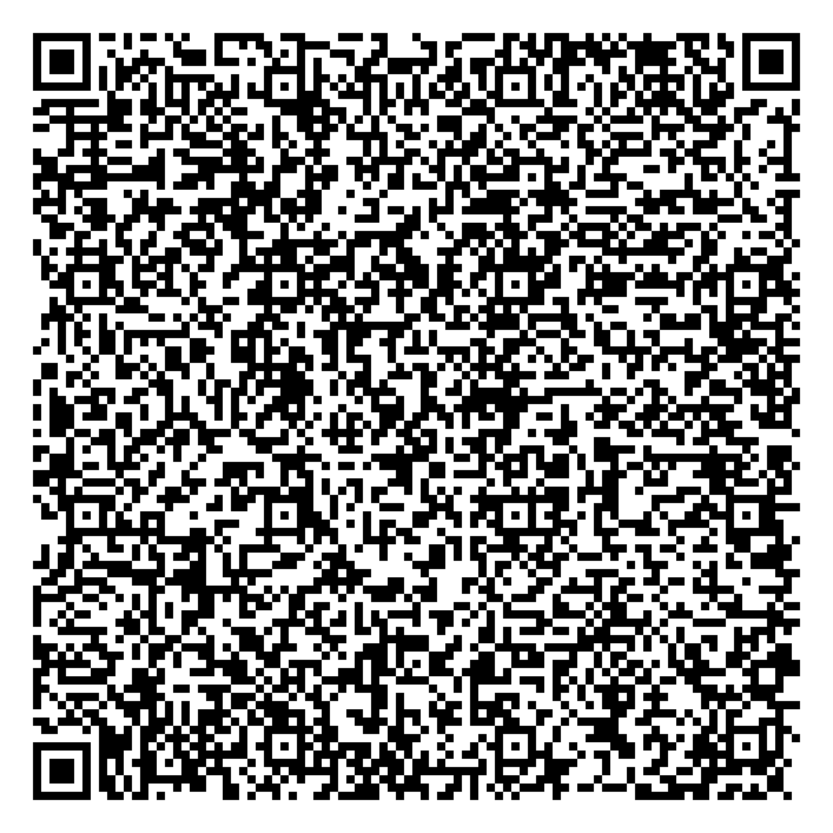


Thank you for attending!
1
2
3
Scan the QR code to confirm you attended today’s workshop.
Fill out the feedback survey in the next 72h.
Get recognition for this workshop on your
co-curricular record.

